Slide 1
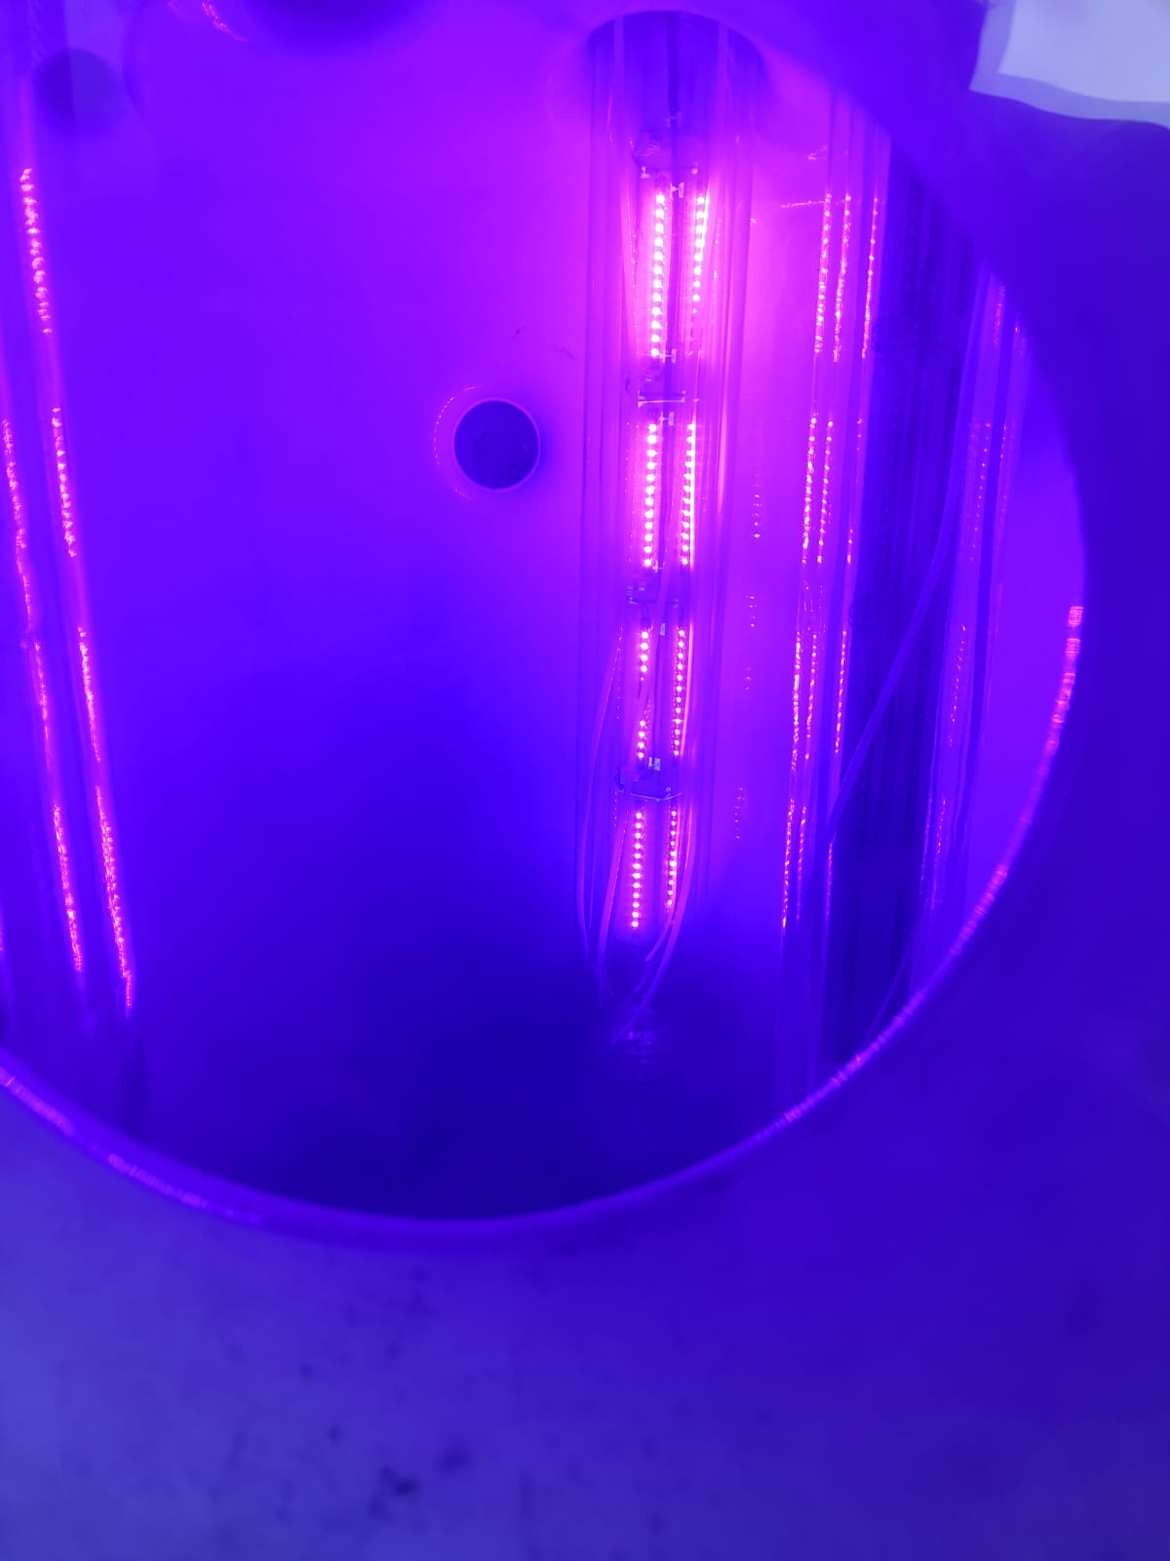
U.V. LED
FOR REACTIONS IN CONFINED SPACE
BY
LACEPL
PATENT APPLICATION NO.: 202421026248
625,626 BROADWAY SIGNATURE, SEVASI-GOTRI ROAD, VADODARA, GUJARAT 391101
&
SECTOR-4, PLOT NO. S-250, 2ND FLOOR, AIROLI, NEAR SHRIDHAR HOSPITAL, NAVI MUMBAI – 400708

Slide 2
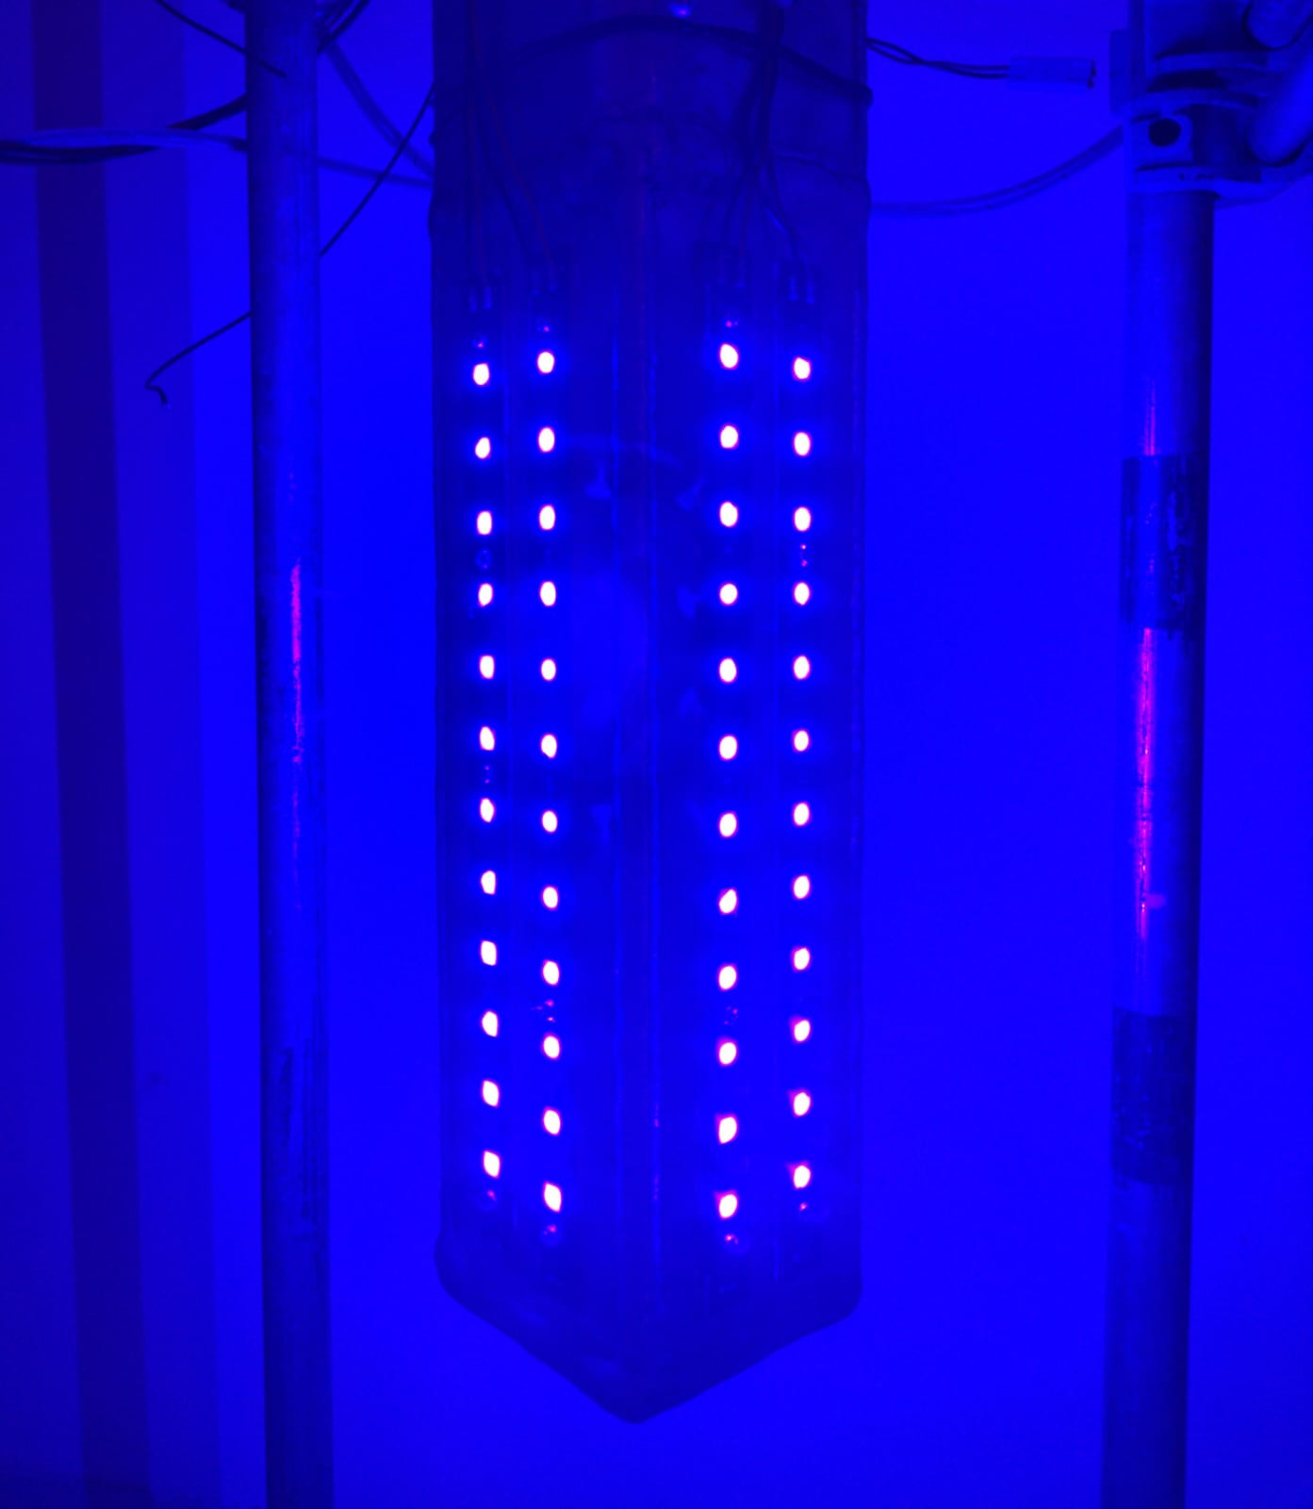
WHY USE LED BASED U.V. LIGHTS
LED BASED SYSTEMS OFFER IMPROVED SOLUTIONS TO CONVENTIONAL U.V. SYSTEMS BY OFFERING:
Better Light output (narrow spectrum output).
Much higher energy efficiency.
Higher lifetime operations.
Better thermal management.
Environmentally Friendly (No mercury content)

Slide 3
COMPARISON OF LED U.V. WITH CONVENTIONAL LAMPS
Comparison | UV LED | UV Lamp (Medium & Low pressure)
Spectral Output | Single peak wavelength | Broadband with multiple peaks
Light Output Stability | Excellent | Comparatively poor
Warm-Up Time | Zero | Up to 15 minutes
Forward Heat Generation | No | High
Driving Mechanism | Simple | Complex
Environmentally Friendly | Yes | No, Mercury content
Optical Angle Shaping | Yes | No
Design Flexibility | High | Low
Product Size | Compact | Large
Lifetimes | Up to 12,000 hrs | Up to 9,000 hrs

Slide 4
TYPICAL POWER CONSUMPTIONS

Slide 5
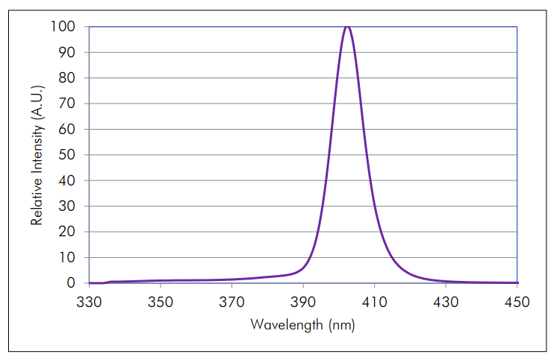
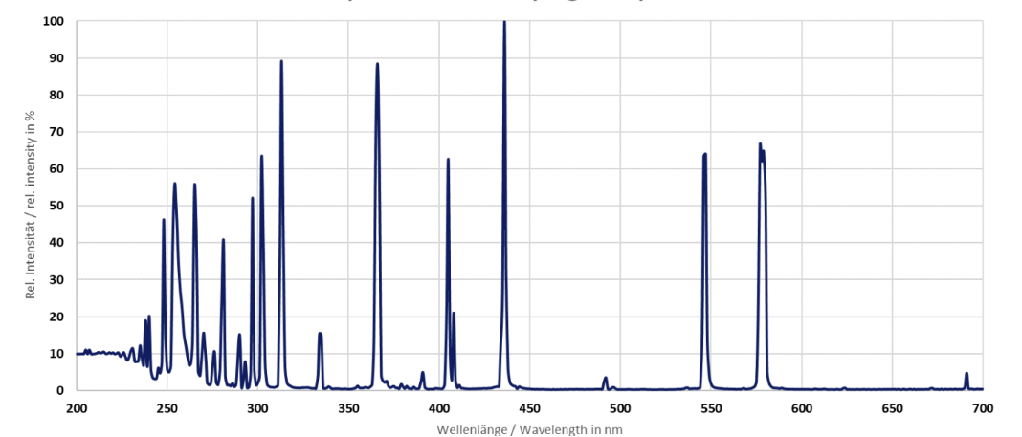
COMPARISON OF OUTPUT SPECTRUM OF U.V. LAMPS
U.V. LED
CONVENTIONAL U.V. LAMP
Near Monochromatic Light With Accuracy Of 10 Nm Variation
Scattered wavelengths

Slide 6
SALIENT FEATURES OF OUR PRODUCT
Highly Configurable System (Can meet R&D to commercial scale design.)
Capacity variation from 1 W output to 15 KW output per reactor.
Light intensity control to suit your reaction conditions.
Easy integration with PLC or DCS.
Long product life, LED life extending beyond 10,000 Hrs. of continuous operation.

Slide 7
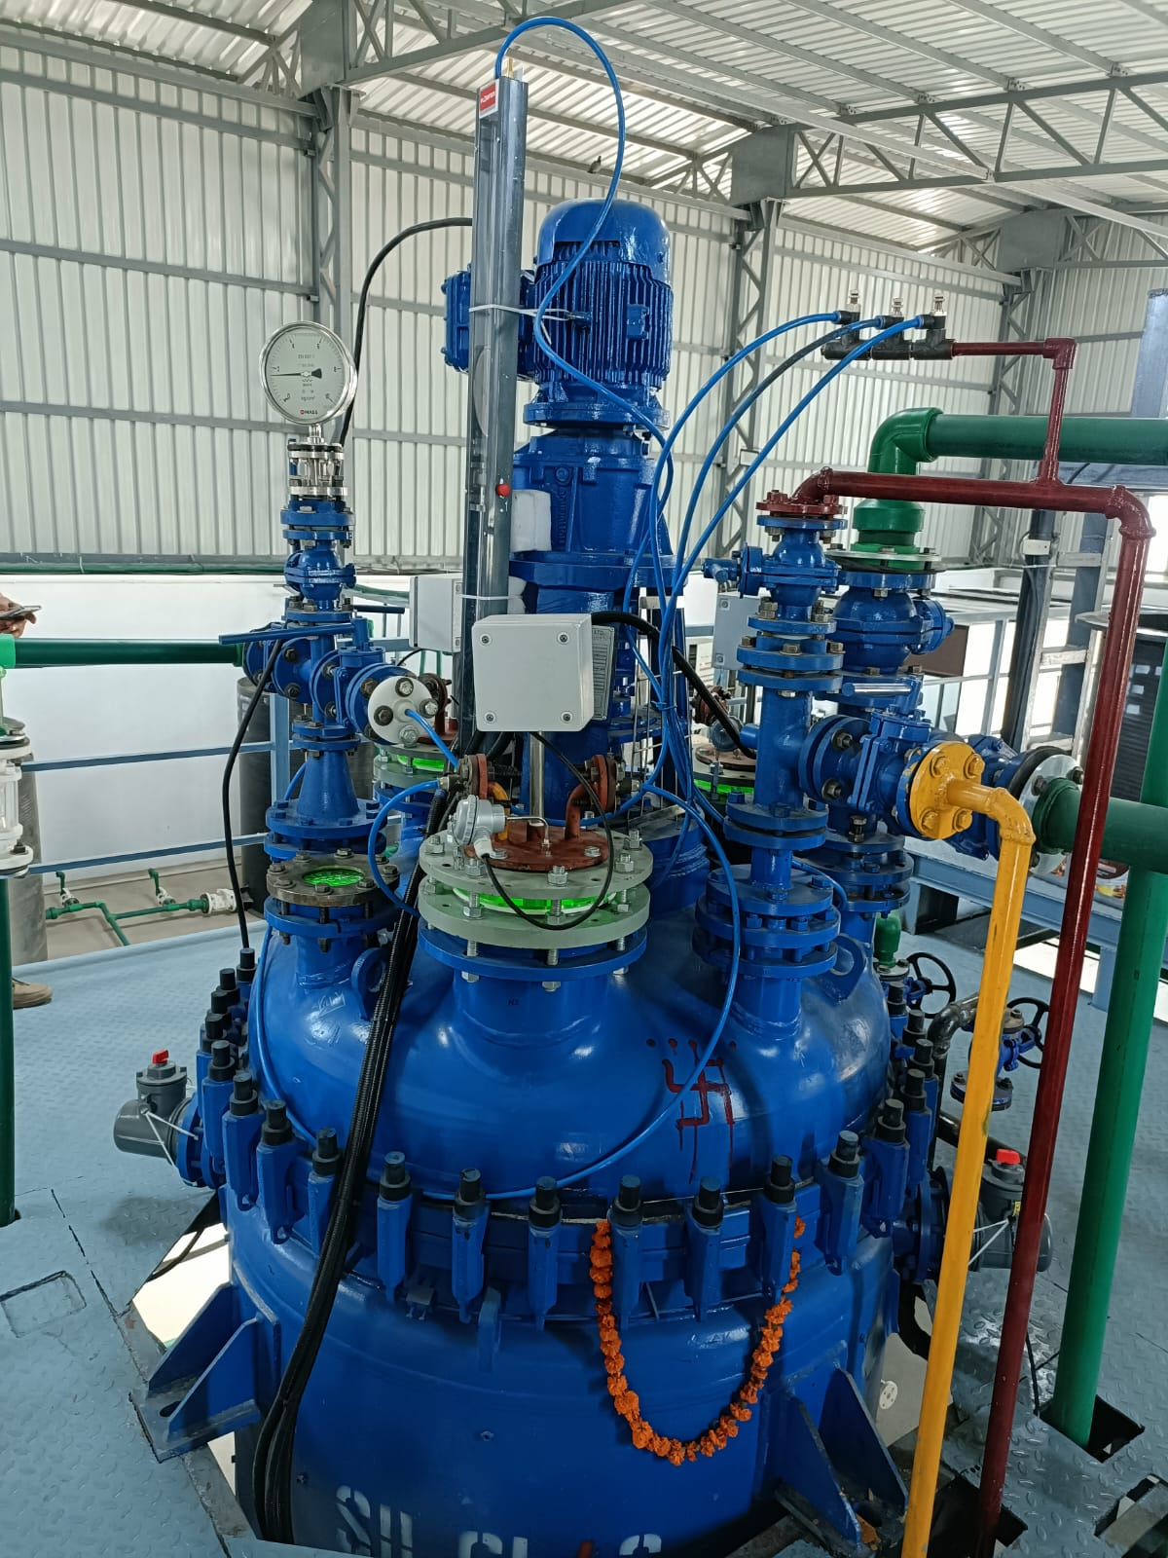
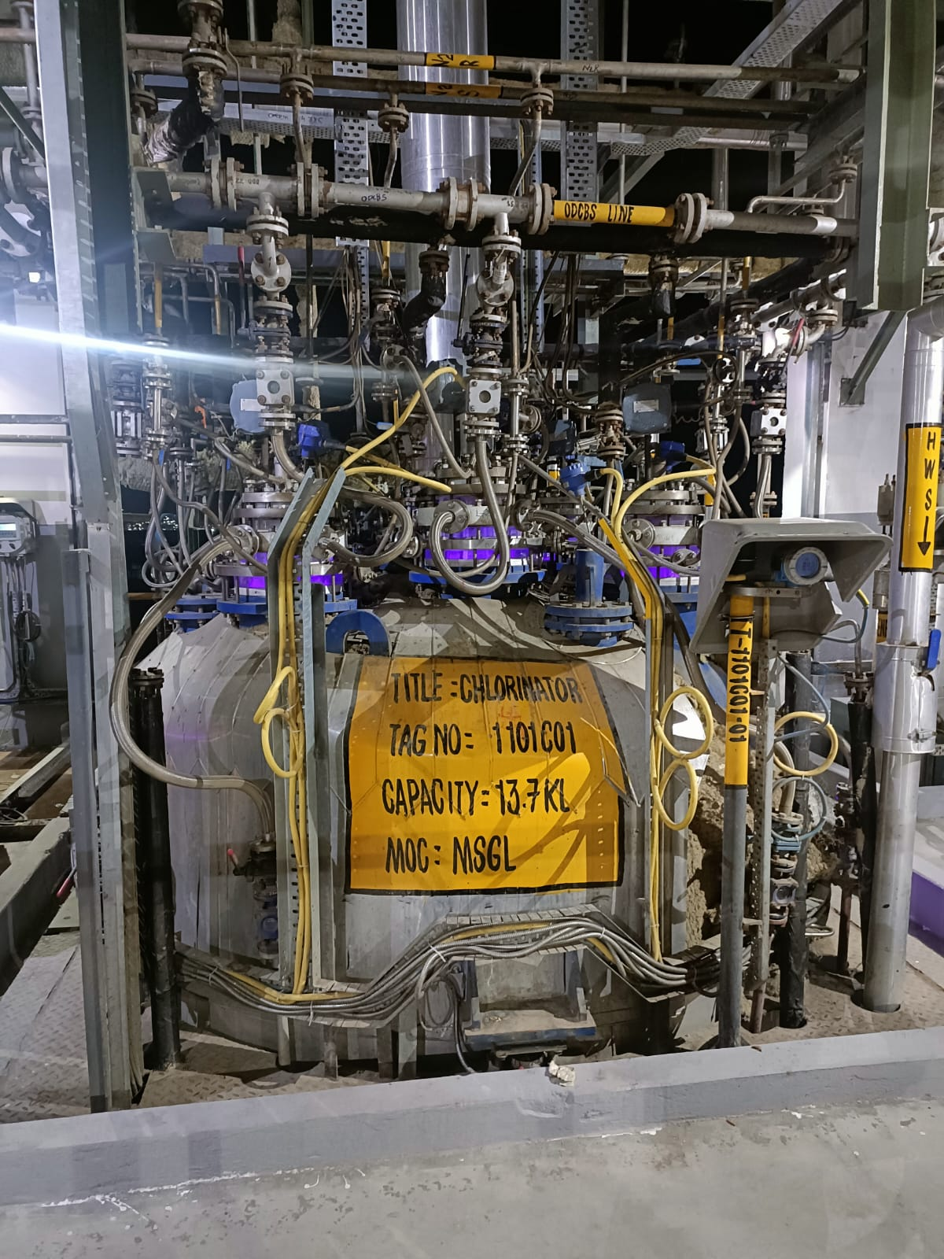
INSTALLATIONS BY LACEPL
1 KL PILOT PLANT
12 KL REACTOR

Slide 8
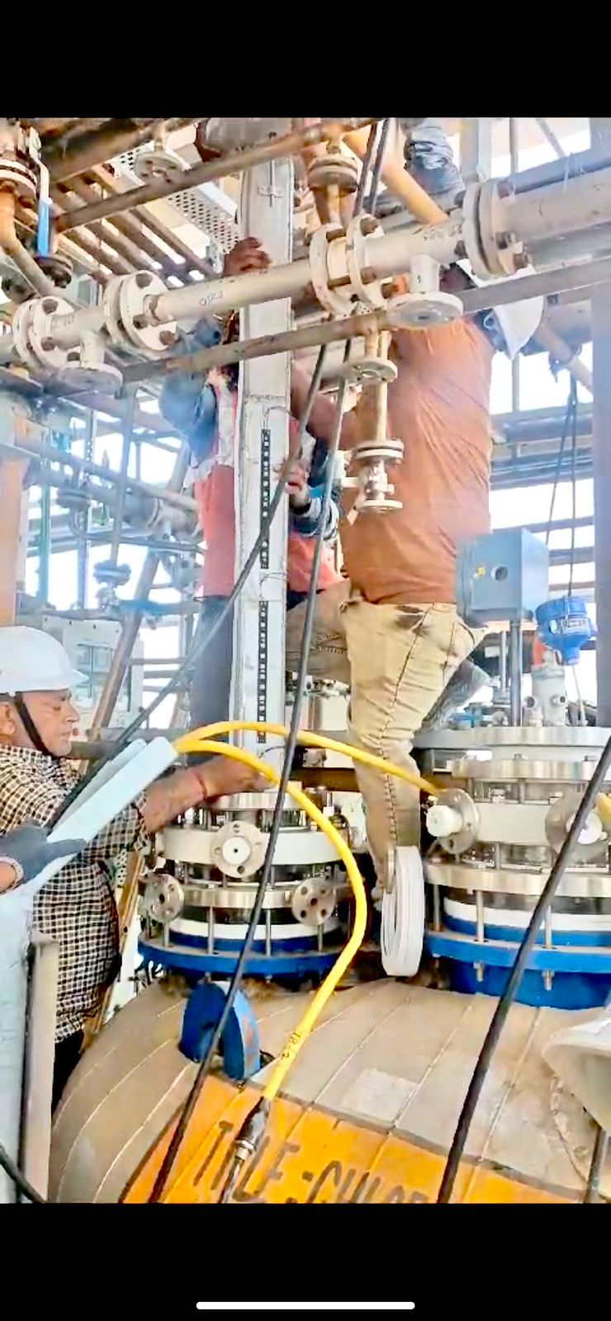
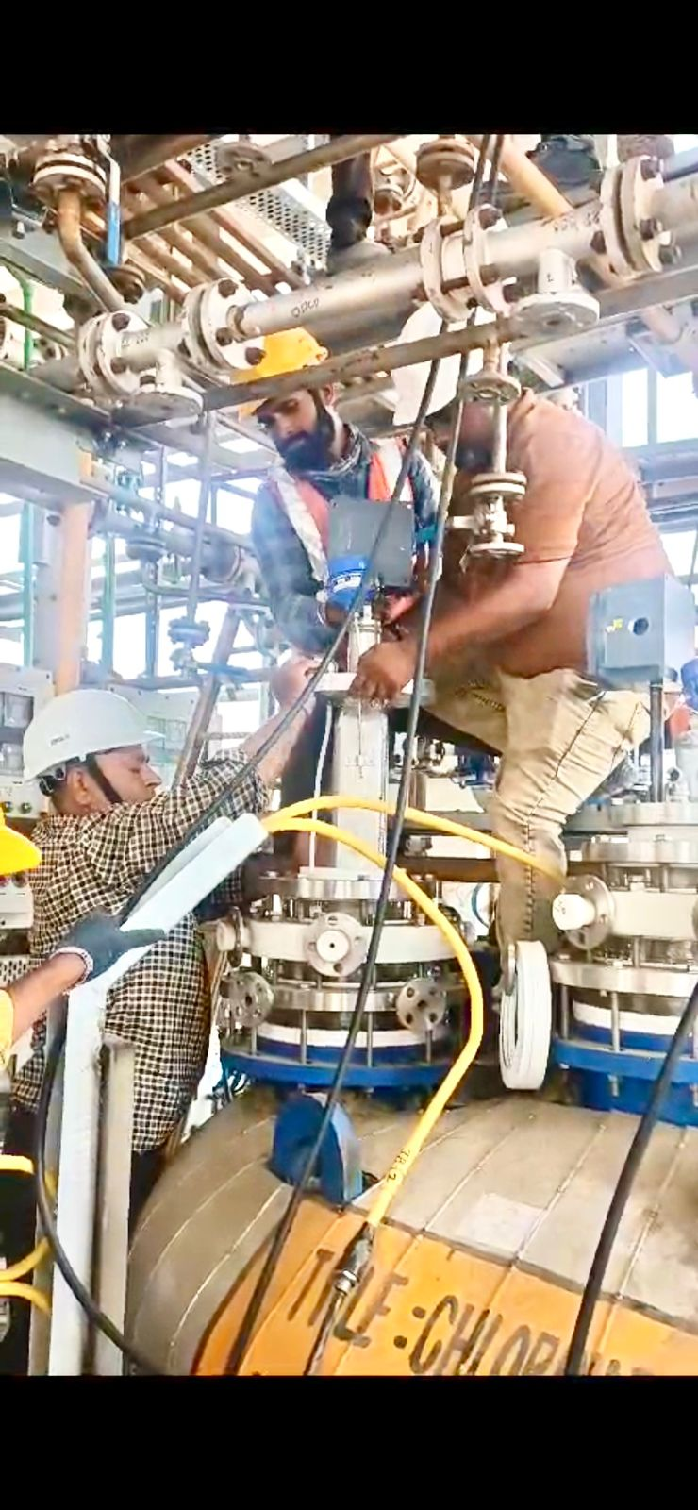
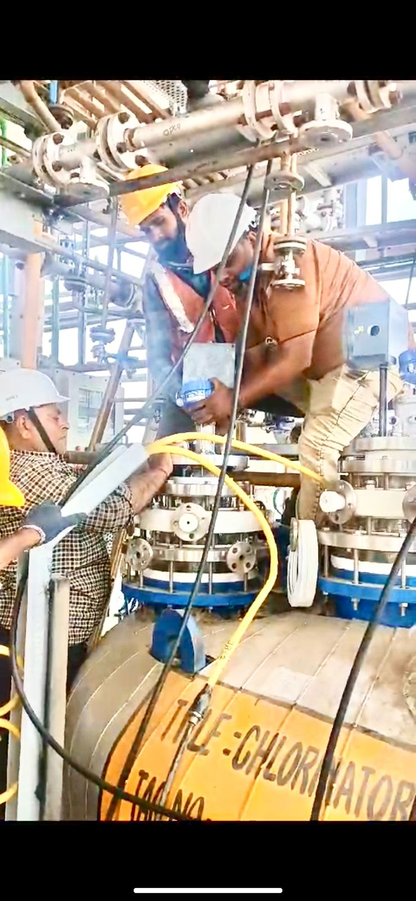
INSTALLATIONS IN PROGRESS

Slide 9
CLIENT LIST & INSTALLATION DETAILS
CLIENT | NEXALON CHEM PVT. LTD. | DEEPAK CHEMTECH LTD.
INSTALLATION CAPACITY | 1 KW | 17.28 KW
CHLORINATOR SIZE | 1 KL (Suspension Photo Chlorination) | 12 KL (Photo Chlorinator
NUMBER OF INSTALLED REACTORS | 1 | 6 Nos.
ORDER EXECUTED | Aug. 2023 | March-2024
SUCCESSFUL RUNNING HOURS | 8000+ Hours | 4000 Hrs

Slide 10
CURRENT ORDERS UNDER EXECUTION
CLIENT | NEXALON CHEM PVT. LTD.
INSTALLATION CAPACITY | 112 KW
CHLORINATOR SIZE | 32 KL (Agitated Photo Chlorination)
NUMBER OF REACTORS | 8

Slide 11
THANKS

